Slide 1
Introduction to the Internet and the Web
Dr. Raj Singh

Slide 2
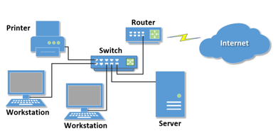
What is a Computer Network?
two or more computers connected together for the purpose of communicating and sharing resources

Slide 3




Types of Networks
PAN - Personal Area Network
LAN - Local Area Network
MAN - Metropolitan Area Network
WAN - Wide Area Network

Slide 4




Intranet & Extranet
Intranet
A private network contained within an organization or business used to share information and resources among coworkers.
Extranet
A private network that securely shares part of an organization’s information or operations with external partners

Slide 5
Internet
The interconnected network of computer networks that spans the globe.

Slide 6


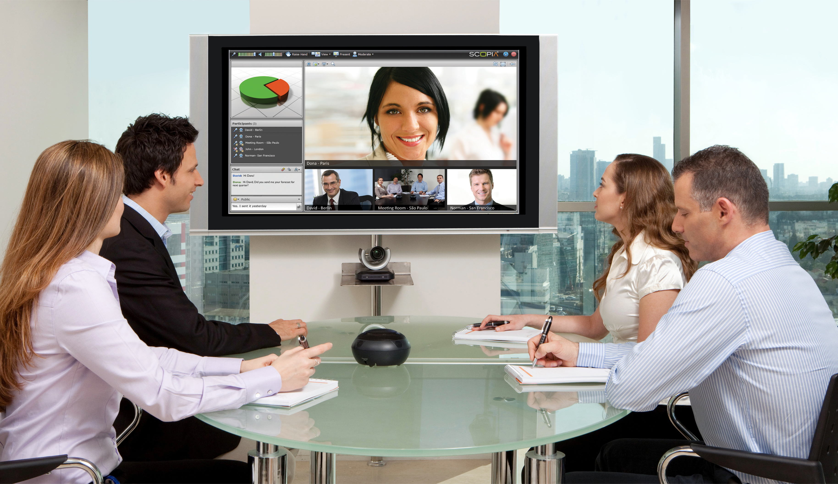
Internet…
Internet has revolutionized our everyday life.
It has changed:
Communication
Education
Shopping
Entertainment
Health care and many more
6￼

Slide 7
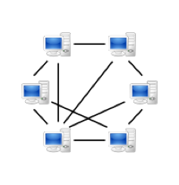
History of the Internet
Began with Point-to-Point (P2P) communication between computers (later Peer-to-peer)
First version of the Internet was called ARPANET Mainly used by universities, scientists, and government agencies to share information
Internet2

Slide 8
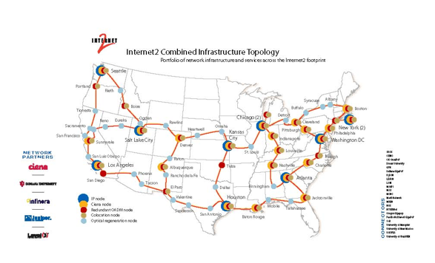
Internet2

Slide 9
Internet
http://www.cablemap.info/
http://www.level3.com/~/media/files/maps/en-network-services-level-3-network-map.ashx#.UUY45xw3t2A

Slide 10




Services Provided by the Internet
Electronic Mail (E-mail)
World Wide Web (WWW)
File Sharing
Alternative to traditional telephone (Voice over IP)
Social Networking
Skype, Google Hangouts, Facetime
Cloud Storage
VMs to provide machines to organizations w/o selling HW.

Slide 11

World Wide Web (WWW)
Not exactly the same as the Internet
Internet is a system of interconnected computer networks
World Wide Web is a collection of text documents and other resources linked by hyperlinks and URLs( Uniform Resource Locator)

Slide 12
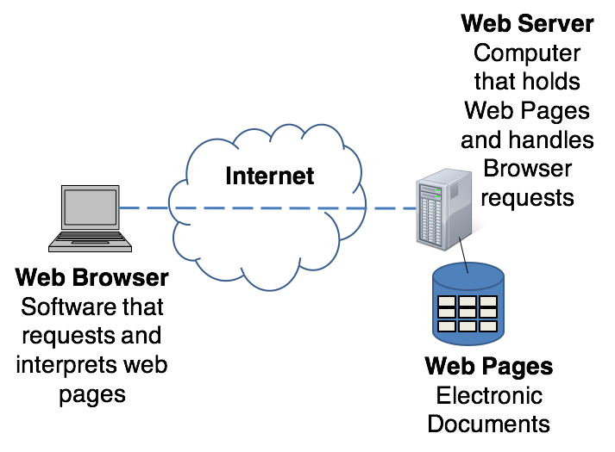
Accessing a Web Page

Slide 13
Protocols
Rules that describe the methods used for clients and servers to communicate with each other over a network.
There is no single protocol that makes the Internet and Web work.
A number of protocols with specific functions are needed.

Slide 14
Some Protocols
SMTP -Simple Mail Transfer Protocol
HTTP - HyperText Transfer Protocol
TCP/IP - Transmission Control Protocol / Internet Protocol
FTP - File Transfer Protocol

Slide 15
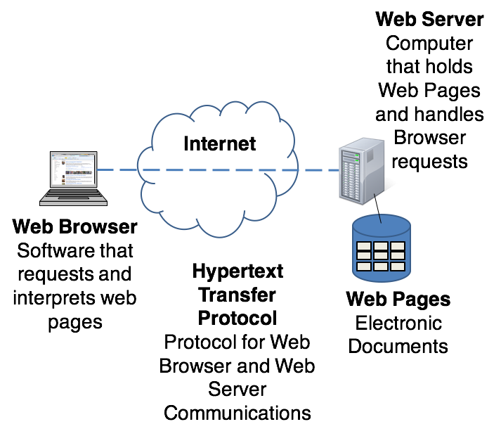
Accessing a Web Page

Slide 16
IP Address
Each device connected to the Internet has a unique numeric IP address.
Two versions of IP addresses:
IPv4:
192.0.2.235
IPv6:
2002:4559:1FE2::4559:1FE2

Slide 17
Domain Name
Locates an organization or other entity on the Internet
Eg: www.google.com
DNS server maps the URL to unique IP address.
Domain Name System

Slide 18
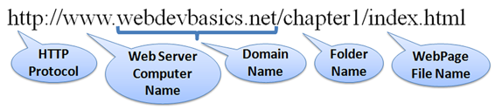
Uniform Resource Identifier
URI – Uniform Resource Identifier
identifies a resource on the Internet
URL – Uniform Resource Locator
a type of URI which represents the network location of a resource such as a web page, a graphic file, or an MP3 file.

Slide 19
TLD Top-Level Domain Name
A top-level domain (TLD) identifies the right-most part of the domain name.
Current generic TLDs: .com, .org, .net, .mil, .gov, .edu, .int, .aero, .asia, .cat, .jobs, .name, .biz, .mobi, .museum, .info, .coop, .post, .pro, .tel, .travel, .xxx

Slide 20
County Code TLDs
Two character codes originally intended to indicate the geographical location (country) of the web site.
In practice, it is fairly easy to obtain a domain name with a country code TLD that is not local to the registrant.
Examples:
.tv, .ws, .au, .jp, .uk
See http://www.iana.org/cctld/cctld-whois.htm

